Slide 1
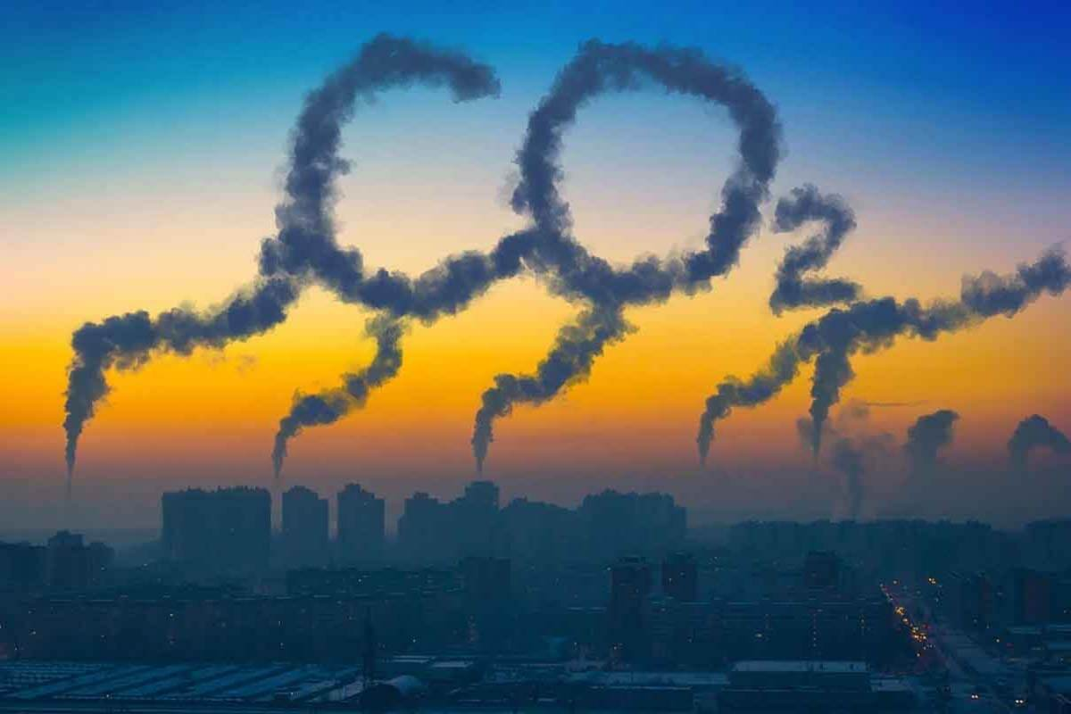
Global CO2 Emissions
Data Visualization Project - Team 1
Xiaolin Ruan, Lucia Tablas, Maddy Hanson, Poonam Fandan
Data Source:
https://www.kaggle.com/datasets/thedevastator/global-fossil-co2-emissions-by-country-2002-2022

Slide 2
Importance
Changes in global temperature
1880 - 1980: ↑ .07℃ per decade
1980 +: ↑ .18℃ per decade
CO2 emissions are the main driver of climate change
Polar ice loss
Ocean temperature increases
Rise in sea level

Slide 3
Emission Types
Coal
Oil
Gas
Cement
Flaring

Slide 4




Methods Used
Dataset
Database
Data Library
JS Library
Notes:
Provide high level overview of the methods used: Kaggle - download dataset, SQL - clean the data, Pandas - analyze the data, JS Library - visualize the data

Slide 5
Main Questions
Which countries are the top emitters of CO2?
Which emission types contribute most to overall CO2 emissions?
What trends can be drawn?
Do we see correlations between increase/decrease in CO2 emissions and increase/decrease in country’s per capita over the years?
What shifts occur in what countries?

Slide 6
Visualizations
Note: Interactive Charts will be displayed during Web Demo

Slide 7
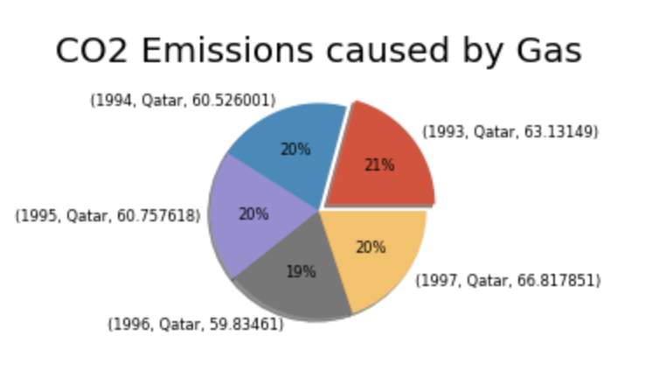
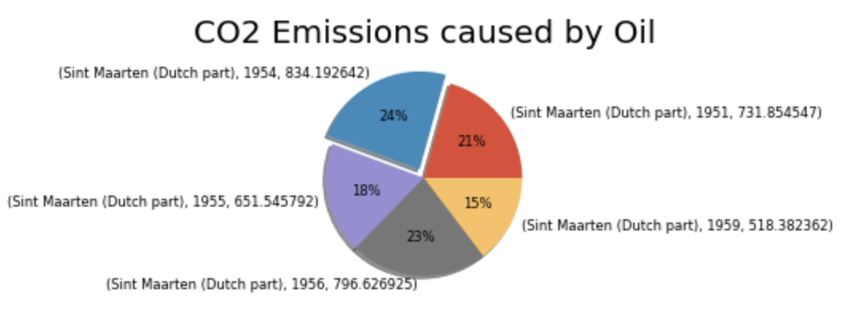
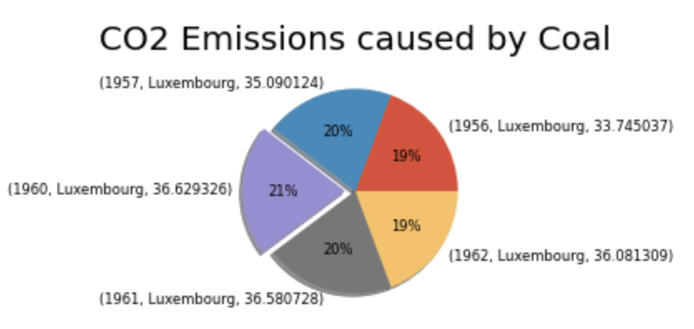
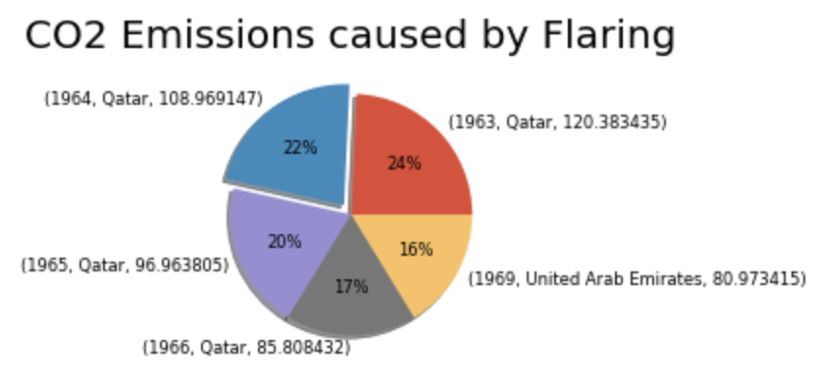
Top 5 contributors of Various CO2 Emissions
-Qatar
-Sint Maarten
-Luxembourg
-Qatar

Slide 8
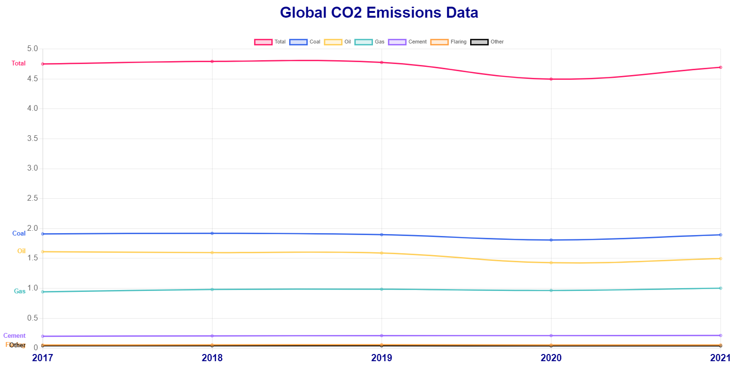

Slide 9
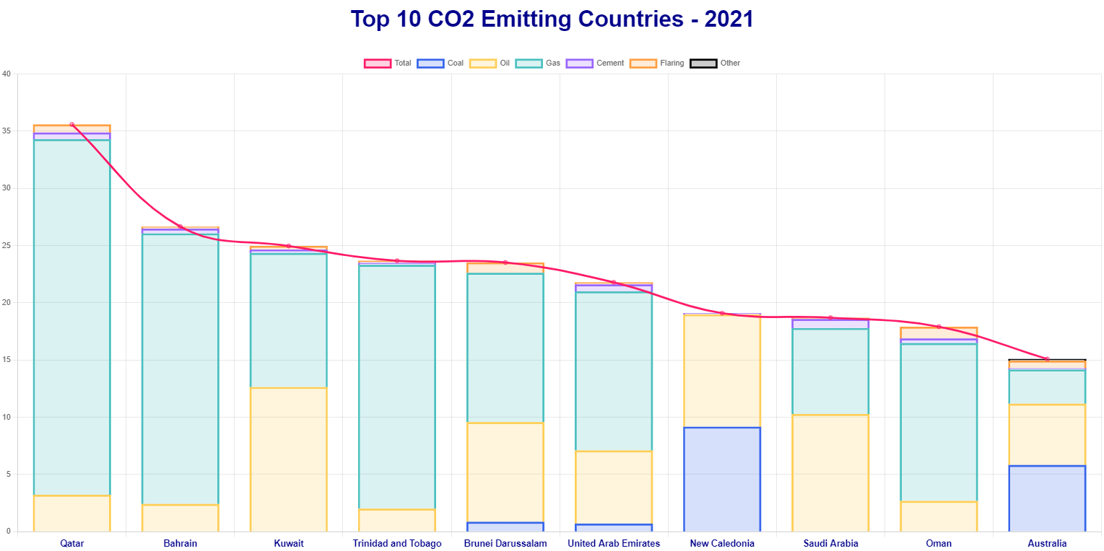

Slide 10
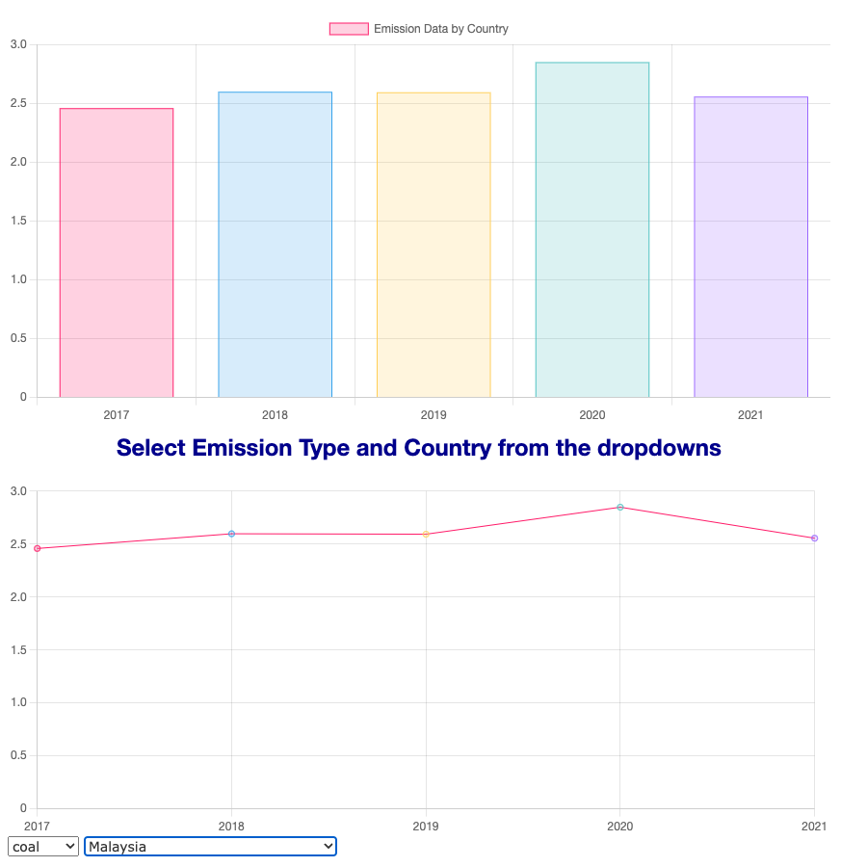
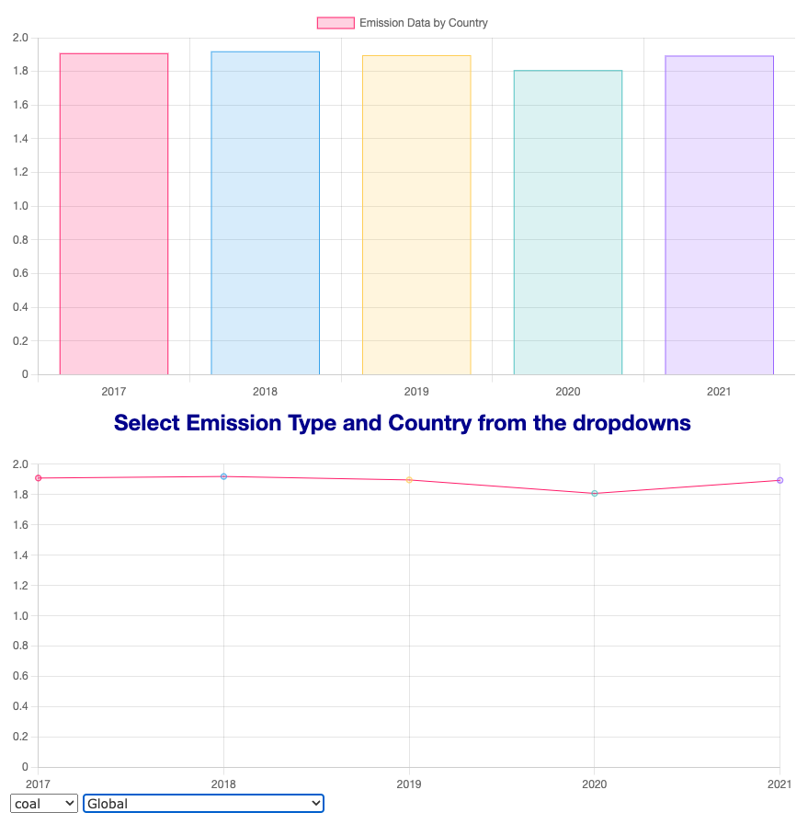

Slide 11


CO2 emissions are the main driver of Climate Change
- Ocean Temperature Increase
- Coal Kills Coral
- Coral Bleaching

Slide 12
Web Demo
https://mhanson16.github.io/Project_03/

Slide 13
Findings
Top CO2 Emission Types:
Coal, Oil, and Gas
Top 5 CO2 Emitting Countries in 2021 (per capita):
Qatar, Bahrain, Kuwait, Trinidad & Tobago, Brunei Darussalam
No Decrease in Global CO2 Emissions per capita in last 5 years
2021 Top Emitter Stats:
Coal: Mongolia - 13 tonnes
Oil: Sint Maarten (Dutch part) - 14 tonnes
Gas: Qatar - 31 tonnes
Cement: Saudi Arabia - 0.7 tonnes
Flaring: Libya - 1.67 tonnes

Slide 14
Resources
https://www.epa.gov/ghgemissions/sources-greenhouse-gas-emissions
https://ourworldindata.org/emissions-by-sector
https://www.ipcc-nggip.iges.or.jp/public/gp/bgp/3_1_Cement_Production.pdf
https://www.epa.gov/greenvehicles/greenhouse-gas-emissions-typical-passenger-vehicle#:~:text=Every%20gallon%20of%20gasoline%20burned%20creates%20about%208%2C887%20grams%20of%20CO2
https://www.energy.gov/fecm/articles/doe-flaring-and-venting-rd-reducing-emissions-and-developing-valuable-low-carbon#:~:text=Flaring%20is%20the%20process%20of,atmosphere%2C%20typically%20in%20small%20amounts
https://news.stanford.edu/2023/01/30/ai-predicts-global-warming-will-exceed-1-5-degrees-2030s/
https://www.chartjs.org/docs/latest/getting-started/
https://www.chartjs3.com/docs/chart/getting-started/
https://www.zubludiving.com/destination/malaysia/sabah/sipadan
https://www.worldwildlife.org/pages/everything-you-need-to-know-about-coral-bleaching-and-how-we-can-stop-it
https://www.marineconservation.org.au/coral-bleaching/

